Slide 1
Wecome to ART with
Ms. Manning
Four (4) people max per table.
Sit alphabetically, by FIRST name
beginning in the front of the room.
(ie: A by the whiteboard, Z in the back)
3. We’ll begin shortly after the bell rings!

Slide 2
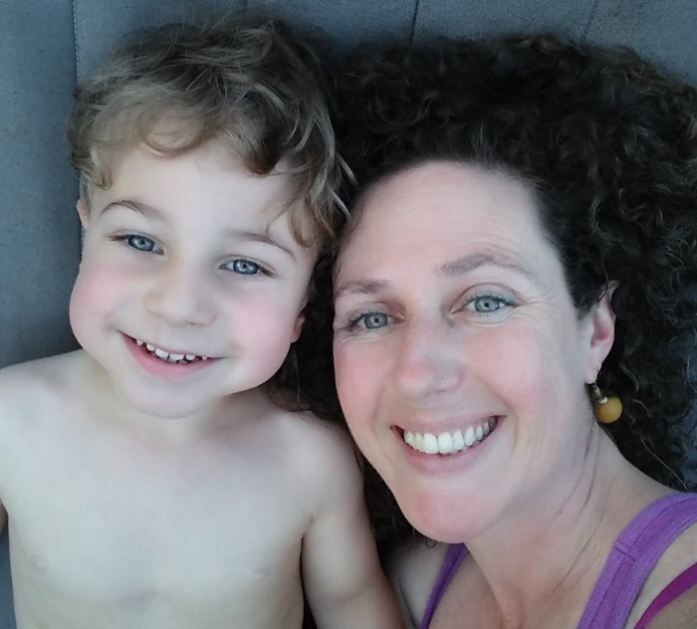
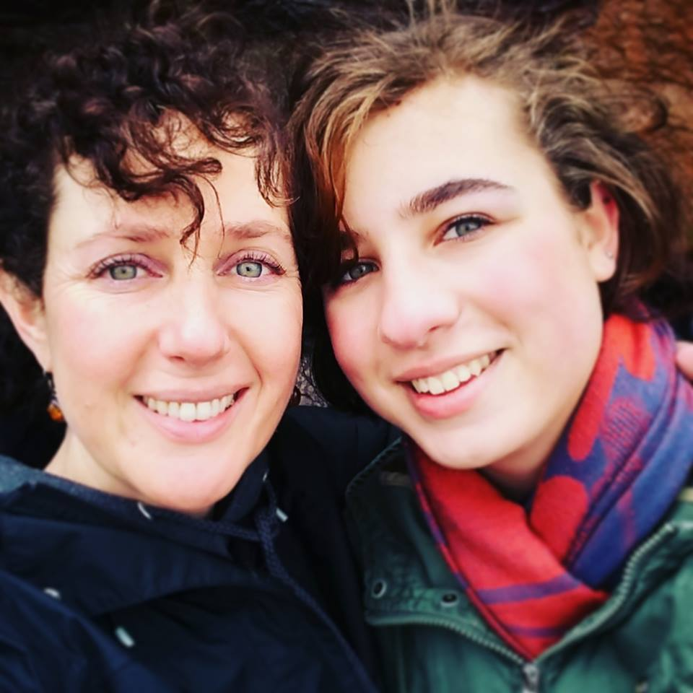
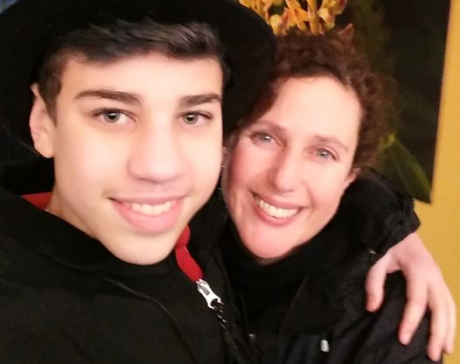
What are my qualifications?
Bachelor’s in Fine Art
Master’s Degree in Teaching
Mom of 3 age gap kids
Certified Aromatherapist in Training
22 years teaching Art
9th year at JHS
Human Being

Slide 3
THE BELL
Be in your seat before the bell rings.
=

Slide 4
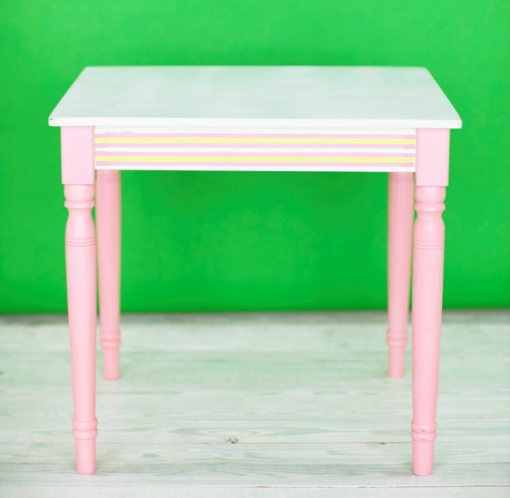
Getting into the Classroom…
Come in quietly. If you’re loud, you’ll be sent out. If it makes you late, you get a JUG.
Put backpacks in hallway cubbies, not in the room.
Bring your iPad and any valuables into the room and put on side counter.
I need to be out in the hallway cubbies!

Slide 5
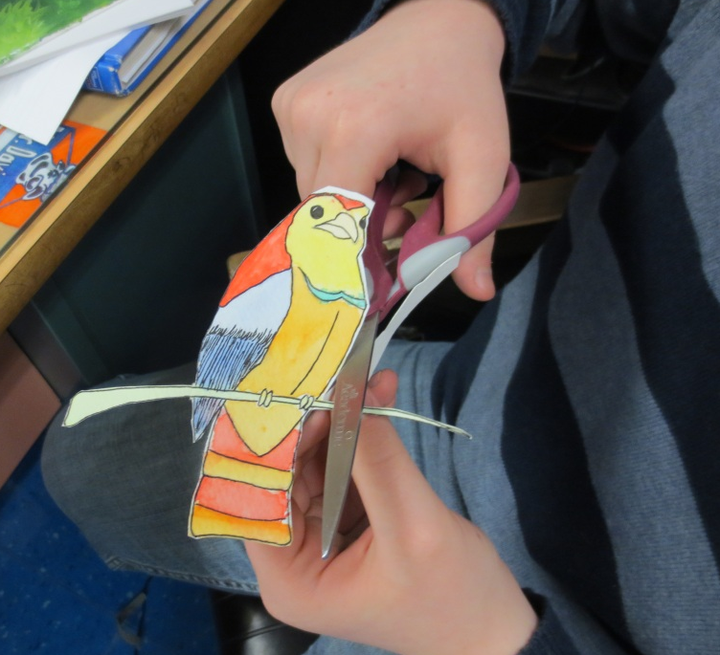
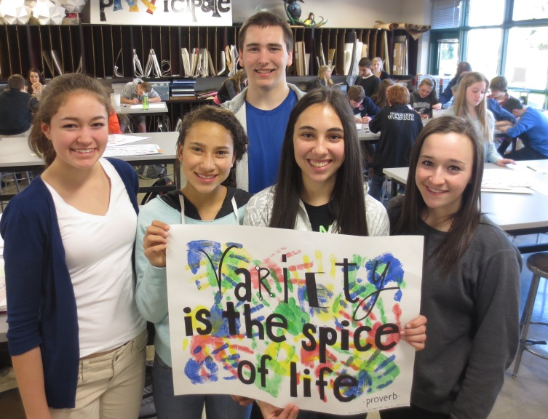
Where am I expected to sit?
Monday | Tuesday | Wednesday | Thursday | Some Fridays
Assigned seats Individual art projects, techniques. Silent working. |  |  |  | Small groups or Open Seating Community arts projects, problem-solving, collaborative art, learning games, creative activities. More social.

Slide 6
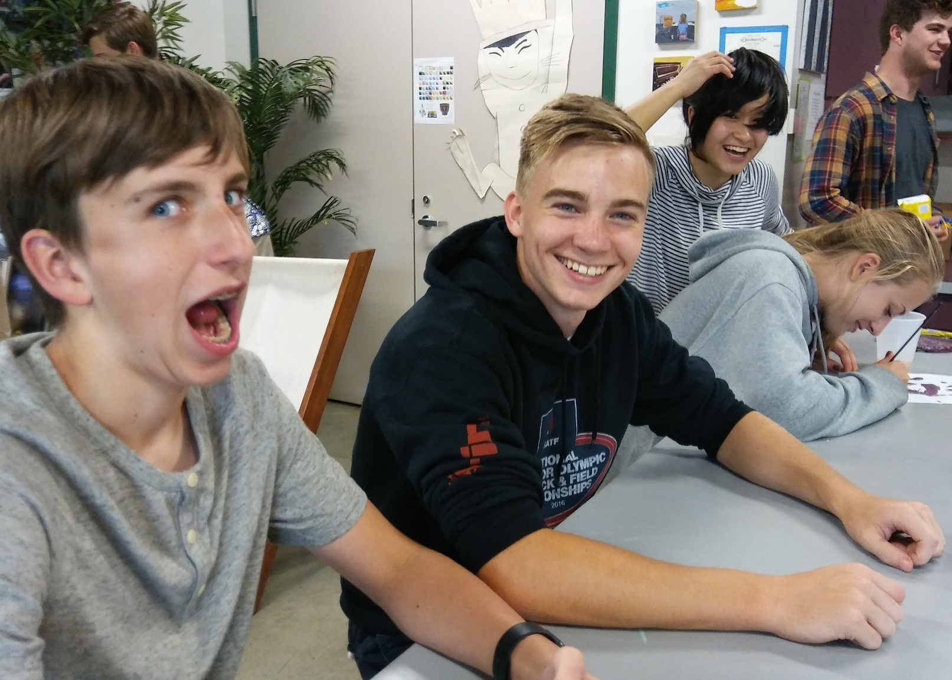
Serious and social…
Omigosh. These kids are so loud. It’s kinda funny but I’m stressing out about getting this done bc I have so much hw tonight, I’m so tired and still have track after school. I wish Mrs. Manning would tell them to shushie bc I don’t want them to think I’m annoying by asking. Omigosh…that was actually kinda funny and I’m smiling now…but it’s too loud in here. I have so much to do. This could be fun but it’s super distracting.
My hair is SO crazy today!
Yackity Yack…omigosh…I’m so excited for Season 8 Game of Thrones!
What?!

Slide 7

Weekly Thought
(30 seconds of silence)
At the beginning of each class we’ll take
a moment to rest our eyes and minds
(No eye contact, talking, etc.)

Slide 8
PICK ONE & Think, Pair, Share:
Do you believe people can be taught to become more creative?
Name three jobs that require creative thinkers.

Slide 9
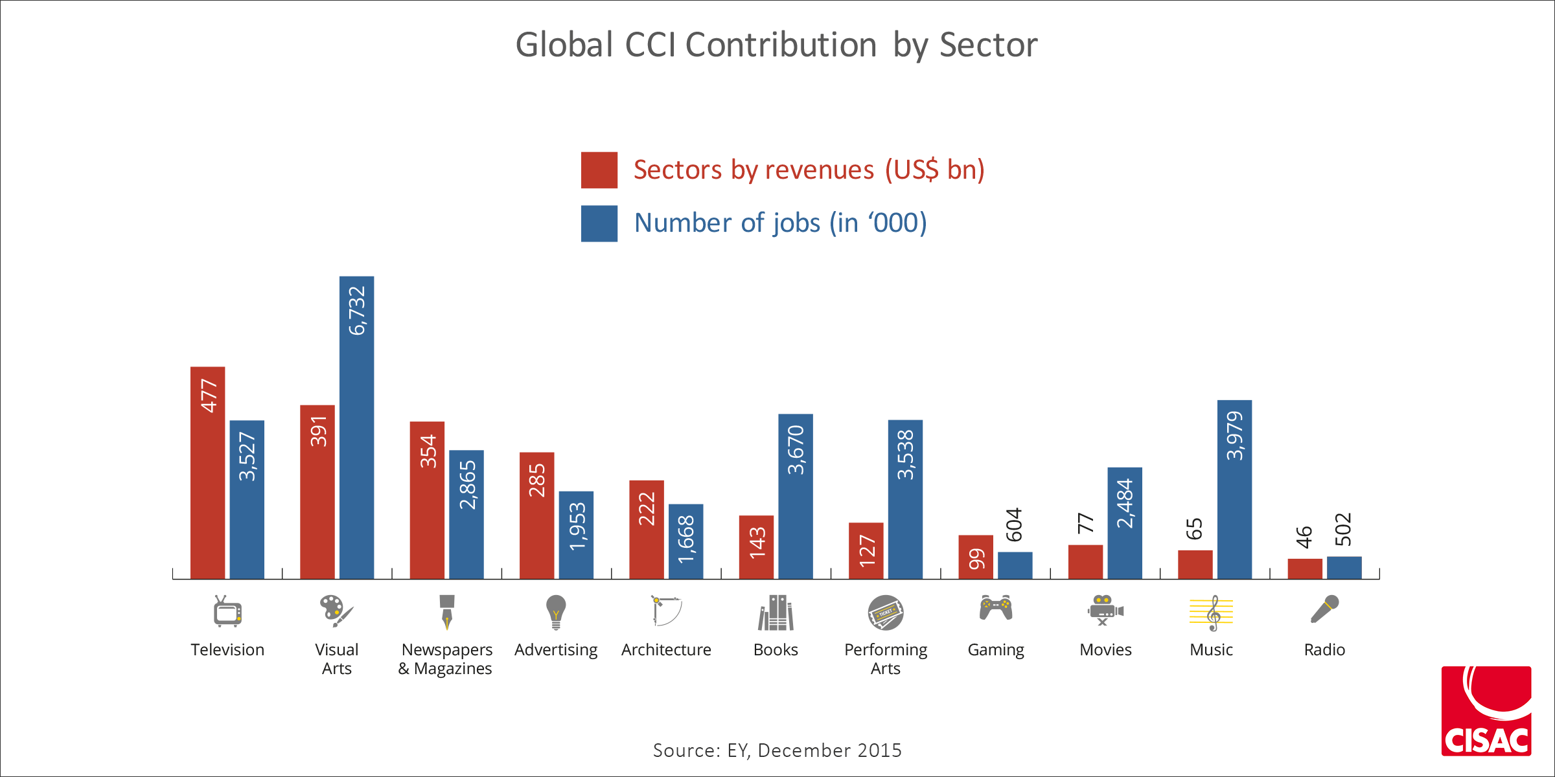
Cultural and Creative Industries

Slide 10
Creative industries generated 29.5 million jobs, which employ about 1% of the world’s active population. The top three employers are visual arts (6.73 million employees), books (3.67 million) and music (3.98 million).
Creative industries also employ more people than the automotive industry in the United States, Europe and Japan combined. (from 2015 research)

Slide 11
BaP Points (10 points / week)
All participating students receive points
Free points?! WHAT?! HOW?!
Behavior –and- Positivity!
Contributions, not disruptions.

Slide 12
What if I’m off task?
Messing around? Bothering others? Not following directions or helping clean up? You’ll be handed a slip and you may also lose some or all of your BaP points for the week.
“In Class – Off Task” slip to fill out that same period
You’ll write an explanation for why even though 55 minutes of class time were provided to work on the assignment, you made the choice to not use that time for that purpose.
You’ll be asked if you plan on turning in a complete assignment done to the best of your ability on or before the due date.
Signature & Parent’s Name / Phone Number

Slide 13
JUG SLIPS
JUG slip policies are in effect in all buildings of the school.
Ms Manning may offer a reminder such as, ‘This is your last reminder’. If you choose to continue what you’re doing, you will lose BaP points and you may also receive a JUG.
In some cases, no reminder is necessary…the ‘reminder step’ is skipped and goes straight to a JUG.

Slide 14
I have to use the Restroom!
Since 3rd and 4th periods have break and lunch right before class, please take advantage of your break to use the restroom.
It’s your responsibility to take care of restroom visits before class.
Ok…so you really have to go. You are allowed 2 visits to the restroom per term. If you choose to use additional visits it will mean you prefer to give up your participation points for the day.

Slide 15
ATTENTION –and- QUESTIONS
Listen up, please! Teacher will raise hand.
Efficient use of classtime
= less homework! ☺
If class takes more than 20 seconds to quiet, that time will be repaid by the class after the bell rings.
Please listen to directions the first time. If you really don’t know what’s going on, you’ve been spacing out, sleeping with your eyes open, then ask your table! If they don’t know, ask Ms. Manning.

Slide 16
Where does our art go?
Your art will go in the labeled slots provided in the back of the room.
If you’re a table helper, please make sure you put your WHOLE ROW’S art in the correct slot.

Slide 17
Handing Out Folders
Folders will be passed out by students closest to the sink counter side of the room. They are in charge of passing out folders to the students in their whole row.
Folders are put away the same way.
Everyone is responsible for helping clean up.

Slide 18



The Creative Classroom
To create a classroom environment where you become more comfortable expressing yourself through art, let’s be KIND TO OURSELVES AND OTHERS.
Thanks! I like the way you did your shading! Meow!
Hey! You sure are doing a great job!

Slide 19


Say something nice!
You look beautiful today.
Thanks! I really like you splotches.

Slide 20
Yays and Nays
I’m looking forward to…
I’m worried that…

Slide 21
1. Share with your group
+
2. Write ONE Yay and Nay on your white board.
3. Share with the class.

Slide 22
What did you come up with?
Yays! | Nays…

Slide 23
No No’s
Banned words: Stupid / Shut up
Feel free to use ‘Please be quiet’ or ‘Shushie’☺
Never, EVER work on anyone else’s artwork (When I show a demo I’ll use my own paper)
No put-downs tolerated.

Slide 24
What Are ‘Mistakes’?!
When we make what we first think is a ‘mistake’, we won’t ‘beat ourselves up’ or put ourselves down. Not even sarcastically.
“Anyone who has never made a mistake has never tried anything new”. –Albert Einstein
“That’s so crazy, it just might work!”
“Always make new mistakes.” -Esther Dyson

Slide 25
Clean Up
Put materials back (check the floor, too!)
Wipe off your table.
Your help cleaning up thoroughly helps everyone leave on time.

Slide 26
DISMISSAL
You will be dismissed by Ms. Manning, not the bell.
Tables that are clean, clear, and quiet will be dismissed first
Last class of the day? Put stools up, please!

Slide 27
Any Questions?

Slide 28
For the Rest of This Class…
Continue working silently on first project (if there’s time!)
Stack up all work by table, then row.
One person will volunteer to put everything away 2 minutes before class ends (I’ll give you a reminder announcement).

Slide 29
Clean up!
Stack up all art / folders from your table and pass them over to the sink-side tables.
The person wearing blue at your table will puts their row’s stack in the back!
The person wearing white at your table will return the bins to their place under the sink.

Slide 30
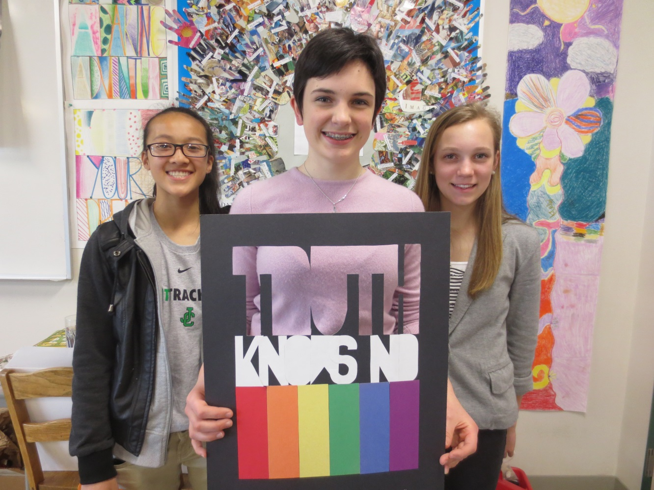

Last year’s poster project:
Hey! I liked making this cool poster with my friends in art class!
It was fun to work together!
Yup.

Slide 31
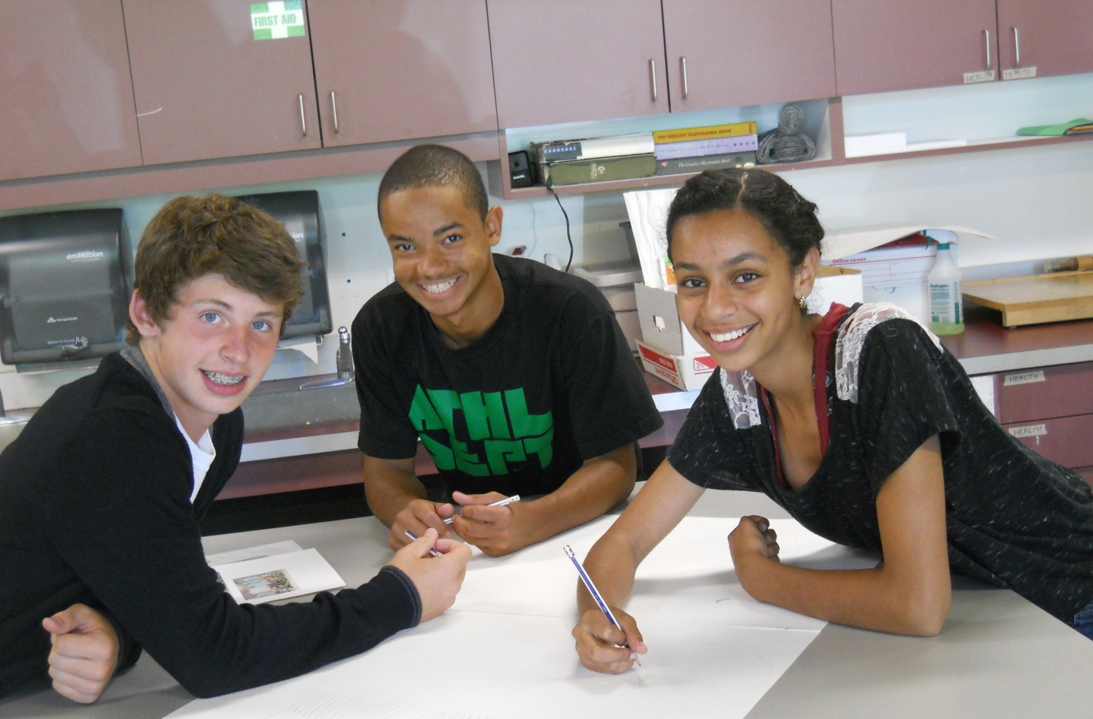
So….what’s our first project?
What will we make first after all of this talking stuff?
We’ll make our art folders.
Whoo hoo!

Slide 32
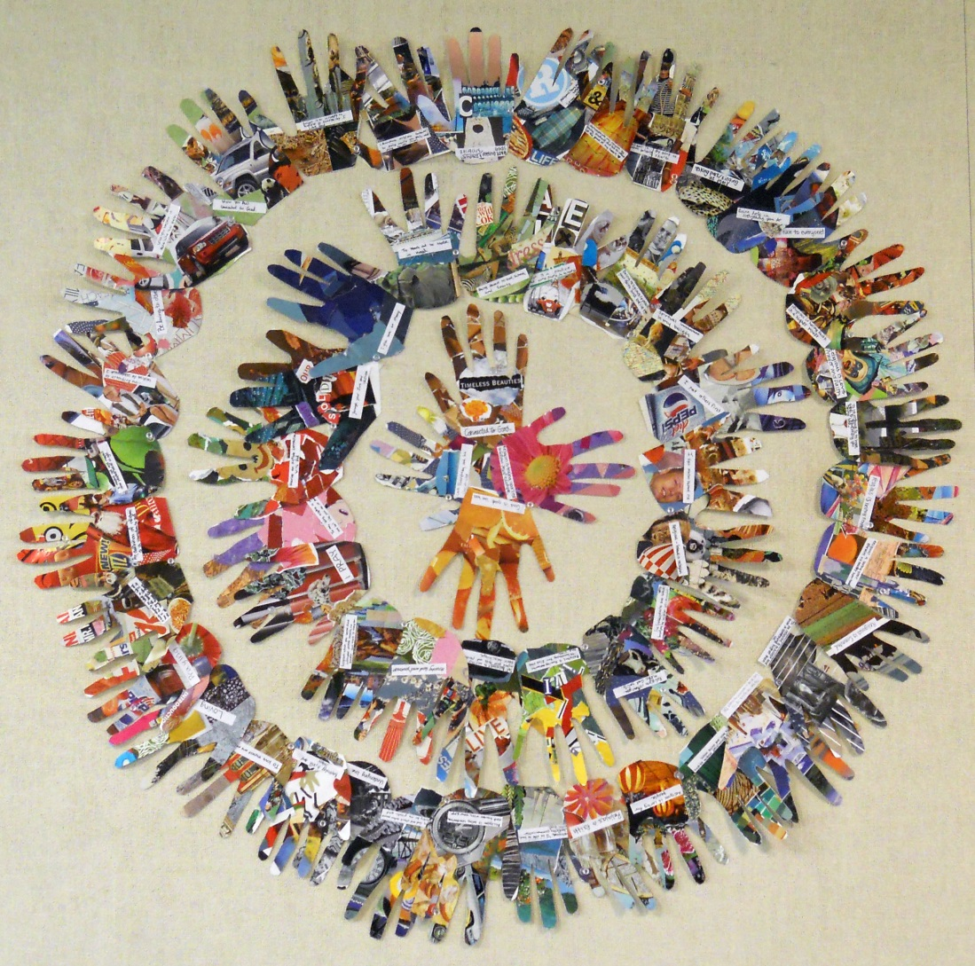
Have a beautiful day!

